Slide 1
USGS Earthquake Data Analysis & Visualisation: The Americas vs. the world (Dates: 17 Dec 24 – 16 Jan 25)
Deirdre Boland
24 Jan 2025

Slide 2
Agenda
Dataset & Initial Investigation
Method
Results
Conclusions

Slide 3
Dataset & Initial investigation
Dataset origin
The USGS(U.S Geological Survey) monitors and reports on earthquakes, their impacts and hazards, and conducts targeted research on the causes and effects of earthquakes.
They USGS provides real-time notifications, feeds and web services about earthquakes.
F Rahman has set up a continuous data set on Kaggle containing details of all earthquakes that have happened in the last 30 days.
Dataset downloaded for analysis covers 17 Dec 24 – 16 Jan 25
Initial investigation
Broad picture analysis
Date, place (longitude, latitude), event type, magnitude and depth data most accessible to non-expert
Excluded error data and more technical data
Sorted dataset for magnitude and depth
highest values contained non American data
lower values predominantly American data
Do we see differences in magnitude, depth and event types when we separate the Americas from the rest of the world?
Reference – Kaggle page: Earthquake

Slide 4
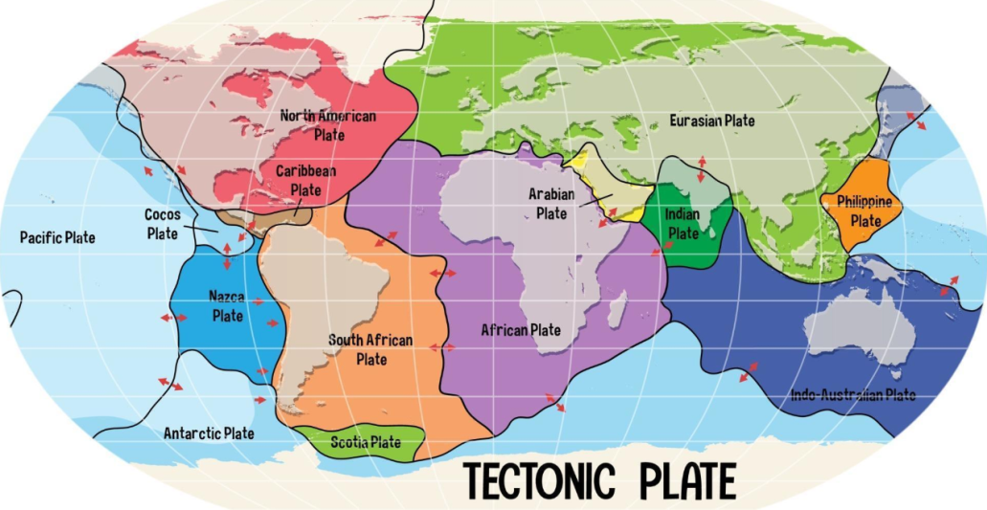
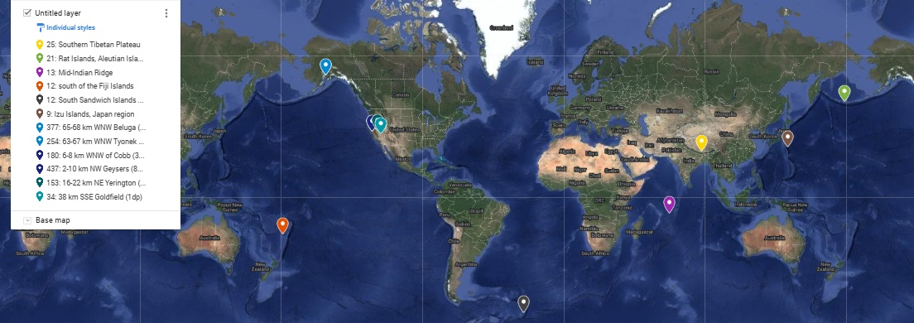
Method
Do we see differences in magnitude, depth and event types when we separate the Americas from the rest of the world?
Created 2 new datasets using longitudes:
North and South America (Americas)
Rest of the world (non-Americas)
Tectonic map, reference: world-map-showing-tectonic-plates-boundaries-free-vector.jpg (1920×980)
The Americas
Custom map showing approximate longitude separation of the 2 datasets: the Americas and the rest of the world: Custom map view link
*place references the closest known populated place in relation to the seismic event (Americas) in Geonames population dataset or a different seismic and geographical scheme is used (rest of work. ANSS Comprehensive Earthquake Catalog (ComCat) Event Terms Documentation

Slide 5
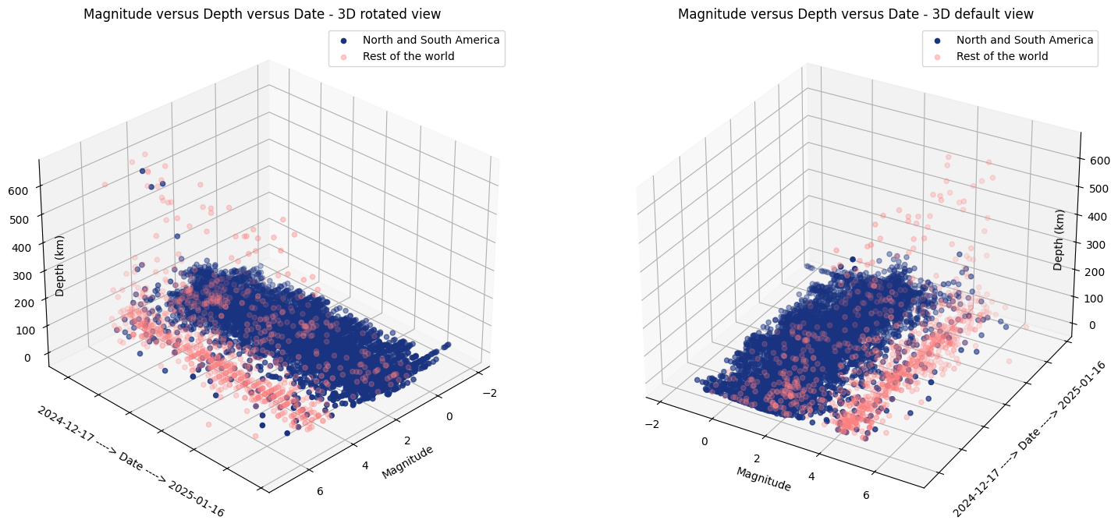
Results – Magnitude vs. Depth vs. Time
More data for Americas (8030) versus rest of the world (1034)
One 3D plot shown at different rotations: higher depth and magnitude data values harder to see on default visualisation (right) versus rotated visualisation (left)
Rest of world data predominantly higher magnitudes and depths versus the Americas
Data relatively consistent day to day - some higher than usual depth/magnitude readings in the Americas mid- late December
*Date axis values converted to float to be plotted and not human readable. Labelled with axis label for readability

Slide 6
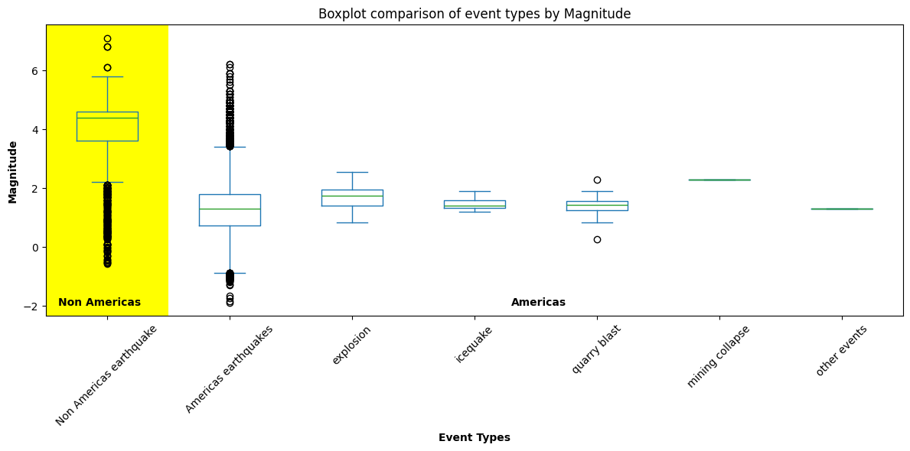
Results – Magnitude of event types
non Americas/rest of the world data only had earthquake event types recorded with predominantly higher magnitudes versus Americas earthquake magnitudes
non Americas/rest of the world earthquake outliers mainly lower magnitude and opposite for Americas
Magnitudes of non earthquake event types for Americas have tighter data spread but similar range of magnitude for the majority of datapoints

Slide 7
Conclusions
USGS captures much more data local to the Americas
USGS data captured from the rest of the world predominantly of greater magnitude
Potential Future work
Review and update code for future proofing with further data sets
Pull and pool more data for longer timeline comparison
More in-depth analysis of places and event types

Slide 8
Q & A

